Slide 1
Miradi 2.0 Navigation Slides
Version: 21 March 2008

Slide 2
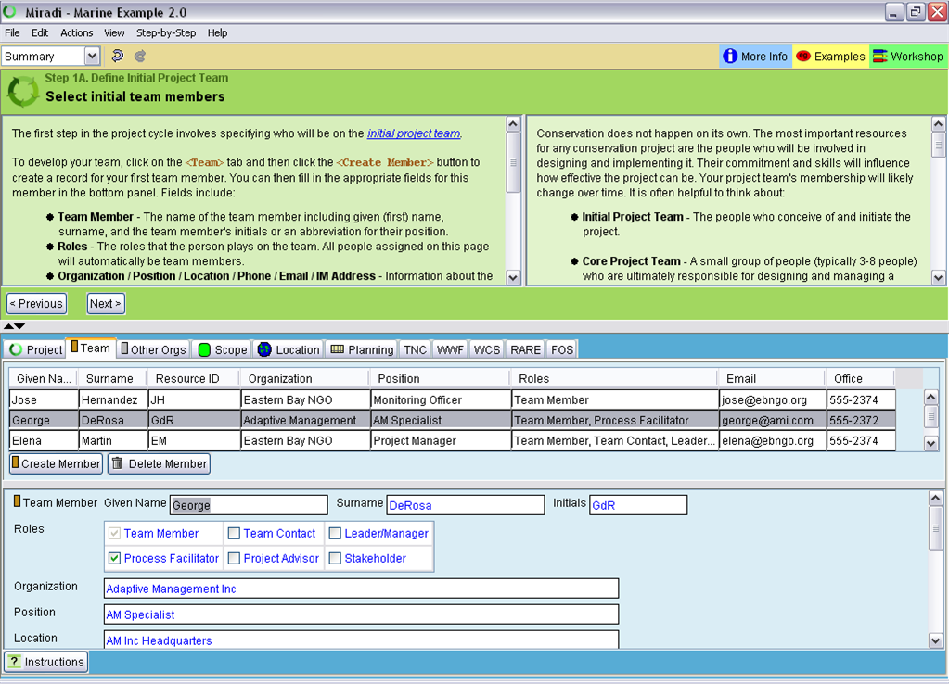
Summary View and General Navigation
Click here for info and hints for each view
Use this menu to go through Open Standards steps
Use this menu to switch between views of project
The left side of the interview pane has step-by-step instructions
The right side of the interview pane provides detailed information
Use these buttons to advance through interview
Many views contain tabs that contain additional info
Splitter resizes interview pane; Arrows show or hide pane
Many views contain an upper table showing summary info and a lower table where info can be edited
Blue text on a white background is user-entered editable data
Instructions button goes to wizard help

Slide 3
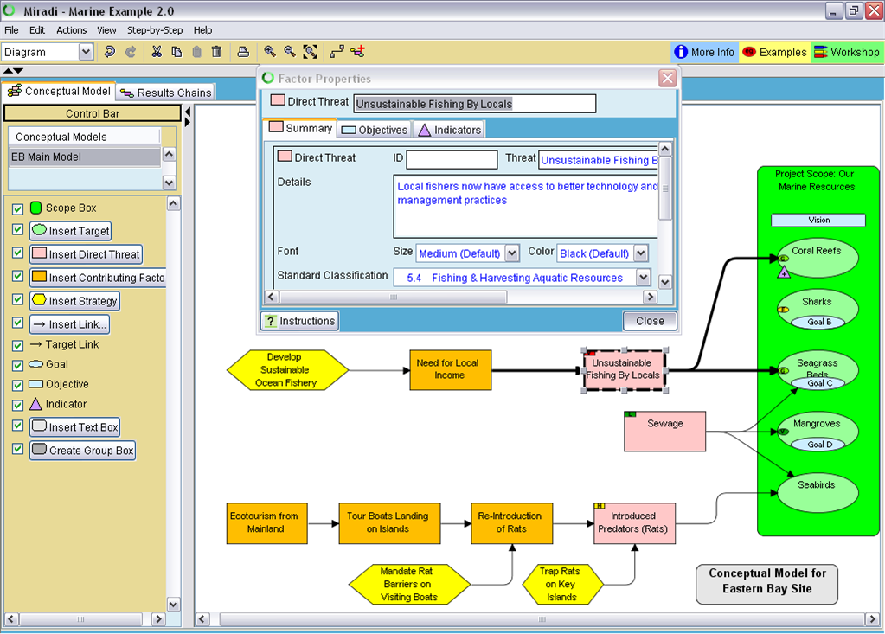
Alt click this tab to show or create a results chain
Type factor name here
Double click factor to get properties
Select diagram pages here
Use ID field to sort tables
Use details field for notes and info
Use these buttons to add new factors & links
Color indicates threat rating
Use checks to control layer display
Use slider to hide legend

Slide 4
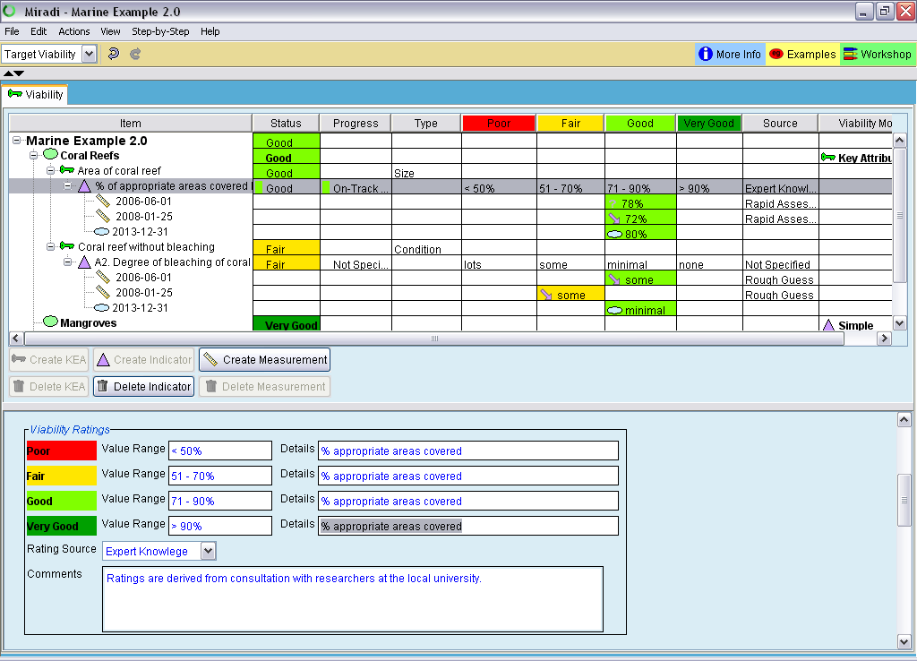
Use diagram factor property box edit targets
Drag and drop columns to adjust their order
Use + and – buttons to expand or collapse tree
Adjust splitter to balance view between table and bottom panel
Use buttons to add or delete rows to table
Use these fields to fill in values for selected row in the upper table
Use comments field for notes and additional info

Slide 5
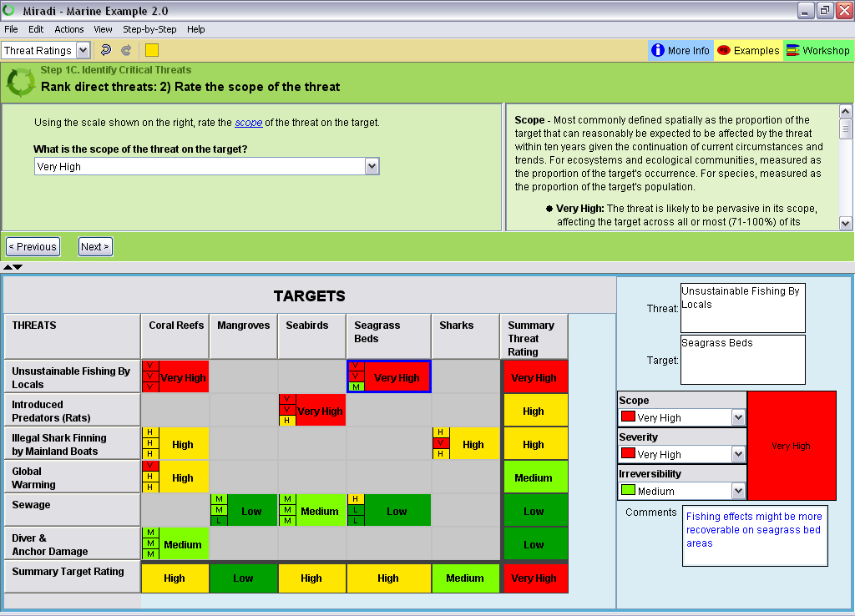
New users should go step-by-step through interview
It is important to read criteria carefully for each rating
Threats are transferred from diagram
Targets are transferred from diagram; click to sort
Experienced users can do ratings directly
Blue frame shows active cell
Alt click cell to add link
Row and column summaries automatically calculated

Slide 6
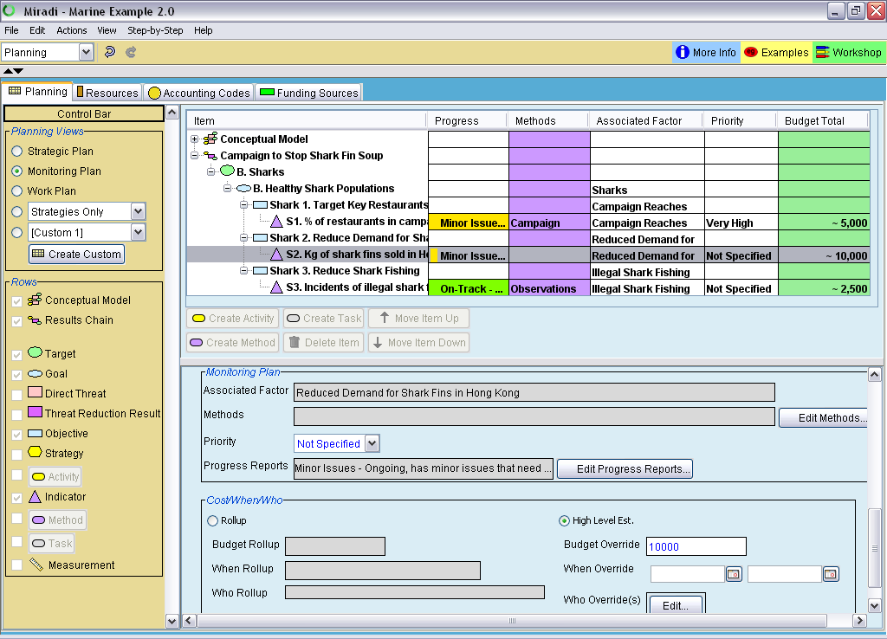
Use radio buttons to select standard sub-views; user can also create custom views
Use + and – buttons to expand or collapse tree
Methods can be rows and/or columns
Selected row in upper table is then editable in bottom panel
Use this button to edit progress reports
Use this button to edit methods
Use check boxes to control display rows and columns in custom views
High level estimates in upper table with a ~

Slide 7
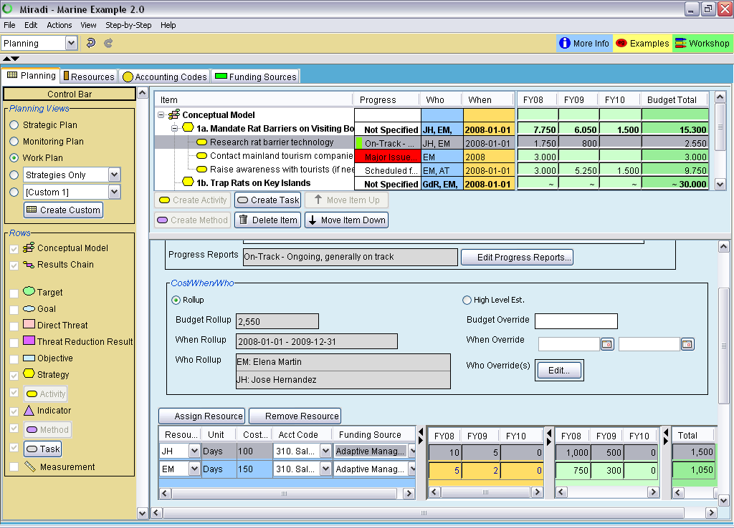
Use these tabs to edit resources, codes, and funding sources
High level estimates in upper table with a ~
Use buttons to order activities and tasks
Use high level estimates to do quick planning
Use this button to create or edit progress reports
Assign resource to do detailed planning (rollup)
Use sliders to adjust view that best fits your data
Orange columns are work units; green columns are costs

